Slide 1
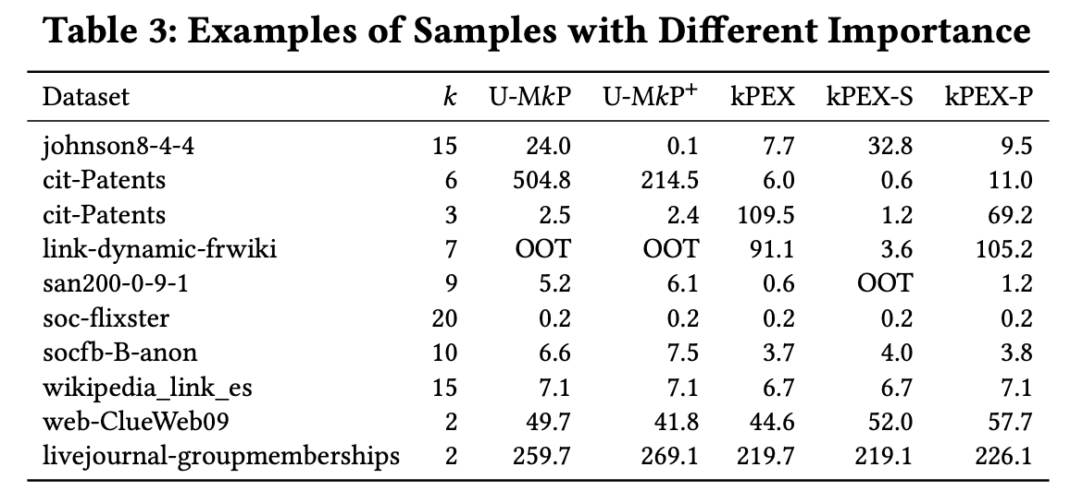
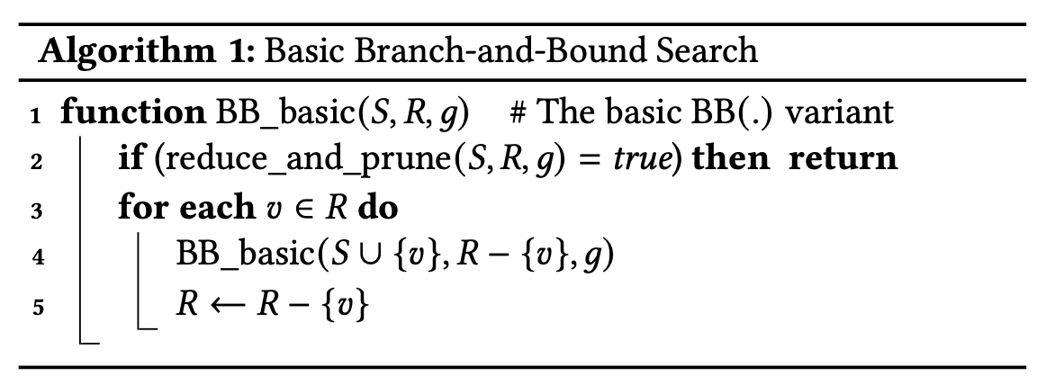
No. of rec calls
UMKP | UMKP+ |  | No. of branches AltRB pruned
3,100,274 | 1902 |  | 310
384,356 | 205 |  | 47
48,028 | 73 |  | 22
5434 | 160 |  | 26
916 | 41 |  | 8
66 | 19 |  | 2

Slide 2
No. of recursive calls

Slide 4
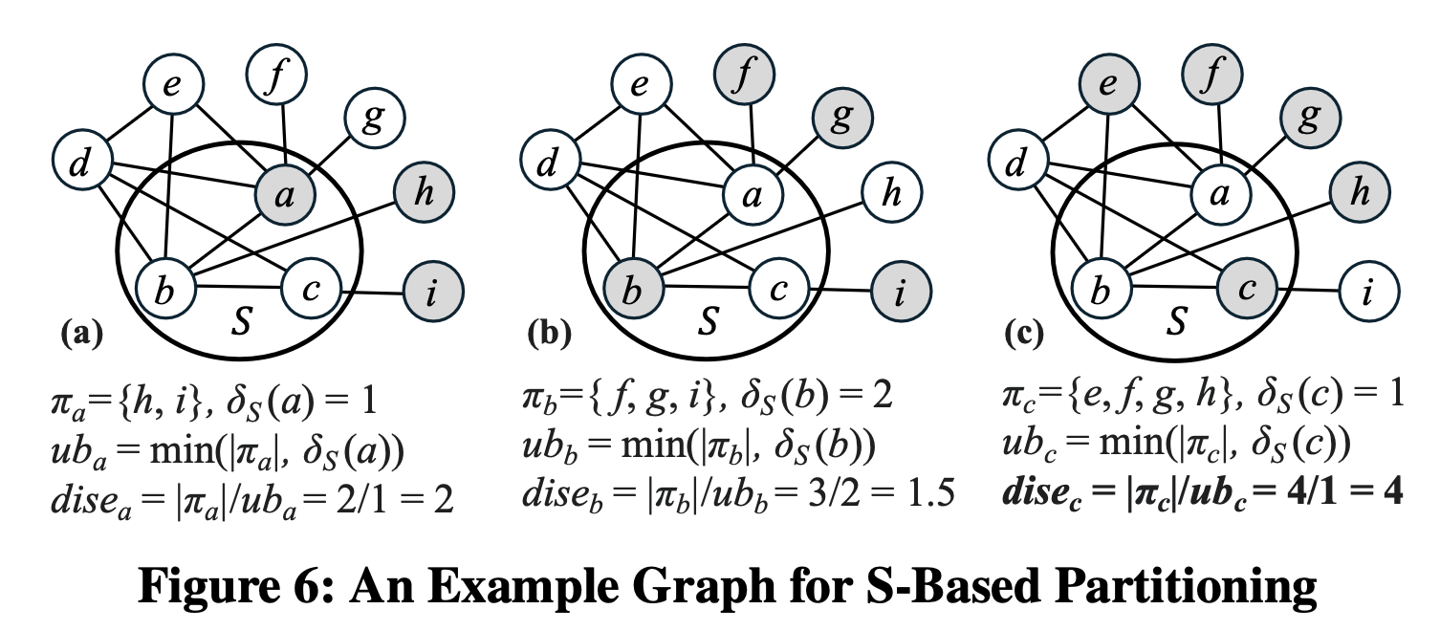
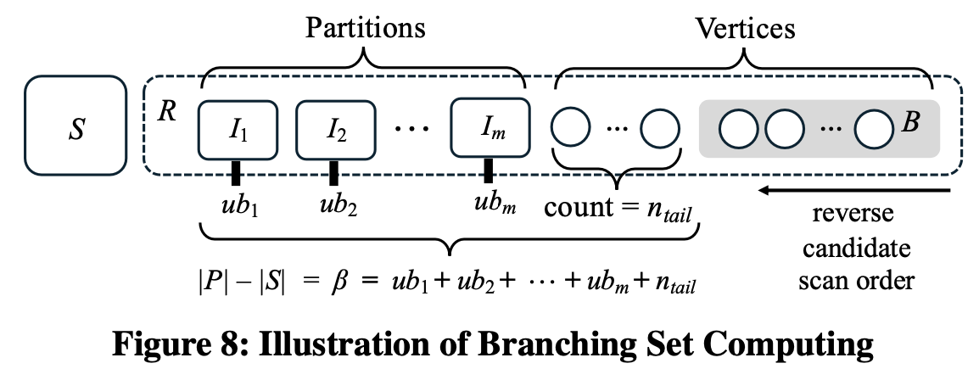

Slide 5
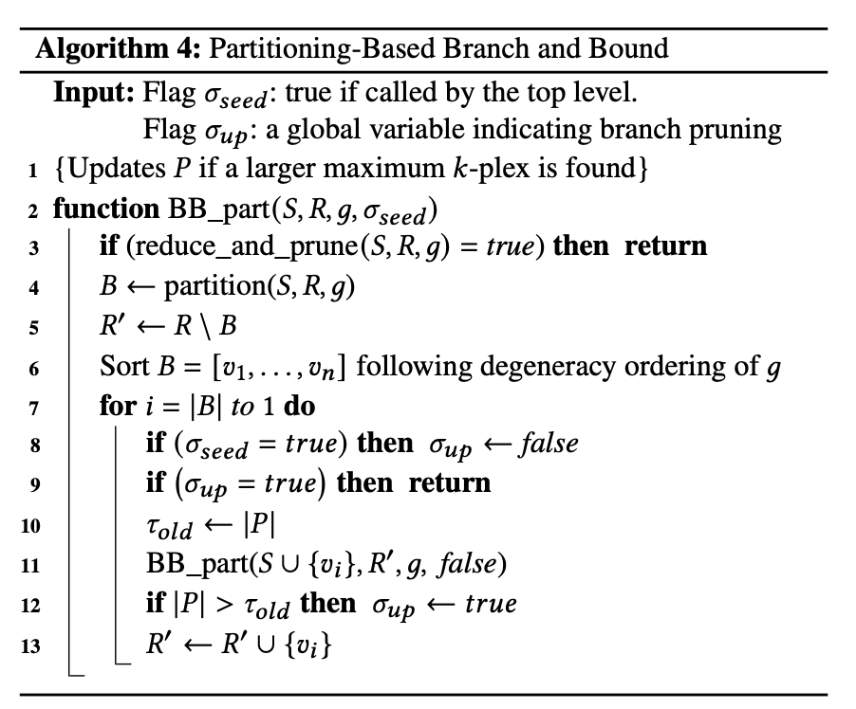








R
Cannot extend S larger than P
$$v_{|B|}$$
$$v_{2}$$
$$v_{1}$$
B
$$R_{B}^{′}$$
$$R_{B−1}^{′}$$
$$R_{1}^{′}$$
d alone cannot provide larger k-plex
{a}
{a, d}
{a, c}
{a, b}
{a, c, d}
{a, b, d}
{a, b, c}
{a, b, c, d}

Slide 6
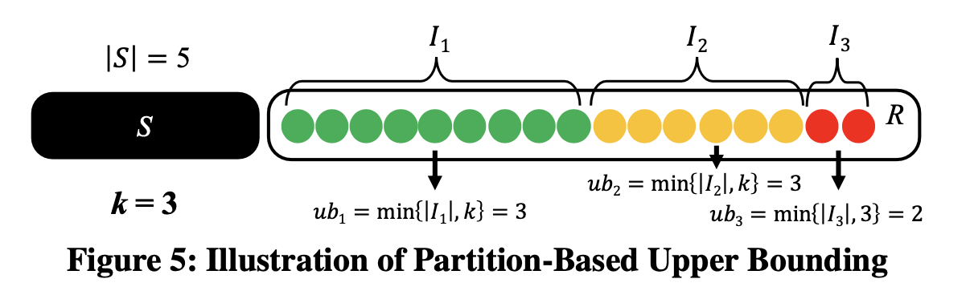
R-Based Partition

